Slide 1


Slide 2

EDU Revolution: Be the Change
New Year
New Beginning
New Excitement

Slide 3
Adder
Subtractor
Combinational Circuits
Comparator
Multiplexer
De-Multiplexer
Encoder
Decoder

Slide 4
Outline
Revision of last class
Comparator

Slide 5
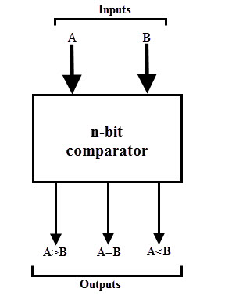
Magnitude Comparator
Magnitude Comparator is a digital comparator which has three output terminals
Equality A = B
Greater than A > B
Less than A < B

Slide 6
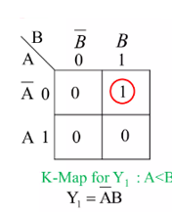
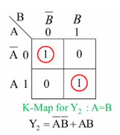
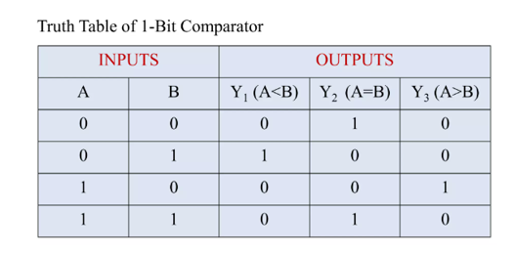
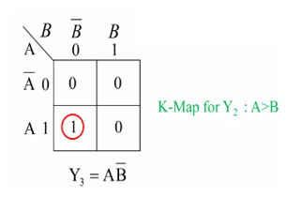
1-bit Magnitude Comparator Circuit

Slide 7
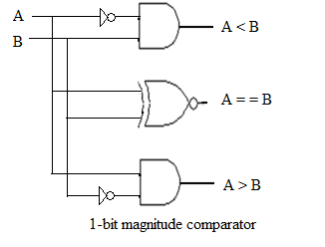
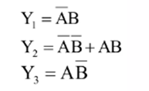
1-bit Magnitude Comparator Circuit

Slide 8
Quick Quiz: Poll
Which one is a basic comparator
a)XOR
b)XNOR
c)AND
d)NAND

Slide 9
Solution of Quick Quiz: Poll
Which one is a basic comparator
a)XOR
b)XNOR
c)AND
d)NAND
Answer: a Explanation: Generally, an XNOR outputs high for even number of 1s or all 0s and outputs low for otherwise. Thus, an XNOR gate is a basic comparator, because its output is “1” only if its two input bits are equal.

Slide 10



